Slide 1
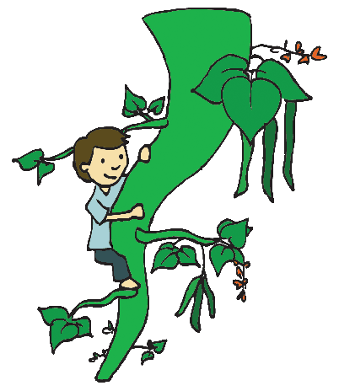
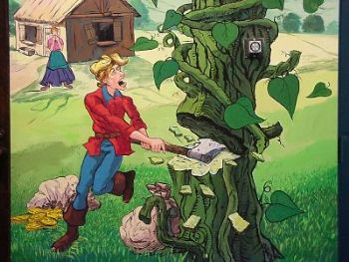
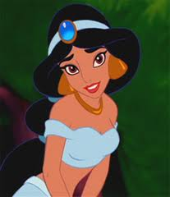
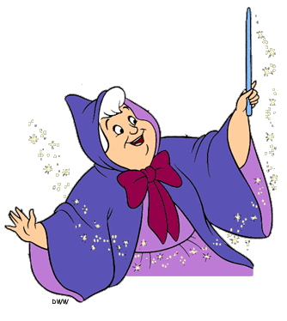
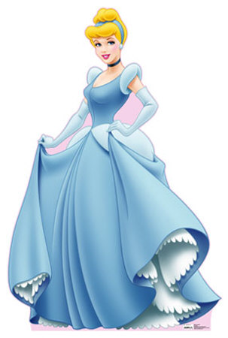
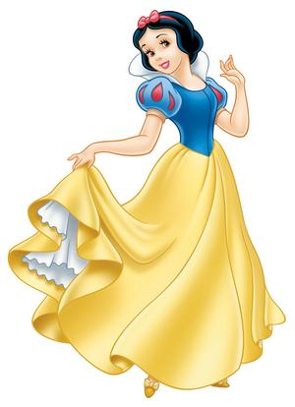
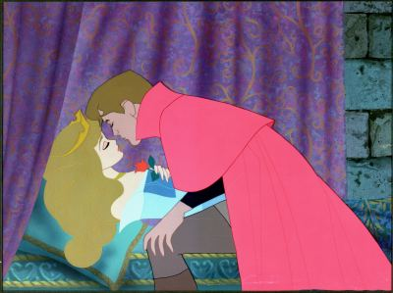
We all know traditional tales well, but what would happen if we changed the ending of a well known tale?

Slide 2
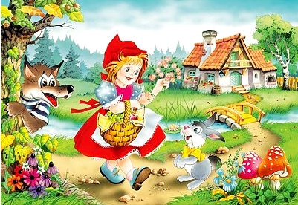
Little red riding hood
The story we all know:
Red riding hood walks through the woods to go and visit her grandmother...
A big bad wolf gets to grandmas house first, locks her in the closet and dresses in her clothes...
When red riding hood arrives she knows something isn’t right with the ‘what big teeth you have...’ conversation...
A wood cutter shows up just in the nick of time to save red riding hood from being eaten up by the wolf...
What could we change and
how would it effect
The outcome of the story?

Slide 3
Snow white
The story we all know:
Snow Whites mother died when she was a baby ... Many years later her father re-married...
Her step-mother had a magic mirror that would tell her she is the most beautiful girl in the land...
One day the magic mirror said that Snow White was now the most beautiful girl in the land and this angered her step-mother who ordered her to be taken into the woods and killed...
The man sent to kill Snow White set her free in the forest and Snow White soon stumbled upon a house that belonged to seven dwarfs who agreed to let snow white stay and soon became very fond of her...
When Snow Whites step-mother realised she was still alive she dressed up in disguise and got her to eat a poison apple that put her to sleep – she could only be woken with true loves kiss...
Finally the handsome prince found Snow White – kissed her and they lived happily ever after!
What could we change and how would it effect the outcome of the story?

Slide 4
Cinderella
The story we all know:
Cinderella lived with her step –mother and two ugly step-sisters... They made Cinderella do all the cooking and cleaning and treated her very badly...
One day the handsome prince invited every maiden in the land to a ball at the palace... Cinderella’s animal friends helped her to make a dress so she could go...
Cinderella’s sisters and step – mother did not want her to go and ruined her dress...
Suddenly Cinderella’s fairy god-mother showed up and helped her get to the ball, under the condition that she had to leave when the clock struck twelve...
Cinderella danced with the prince and fell in love... As the clock struck twelve she left in a hurry and lost her glass slipper...
The prince travelled the land in search of the owner of the glass slipper and eventually found Cinderella... They got married and lived happily ever after!
What could we change and how would it effect the outcome of the story?

Slide 5
Now think about other traditional tales like: Sleeping Beauty or Jack and the beanstalk Your task is to re-write the story again but making a change in the ending so the outcome of the tale is different!

